Slide 1
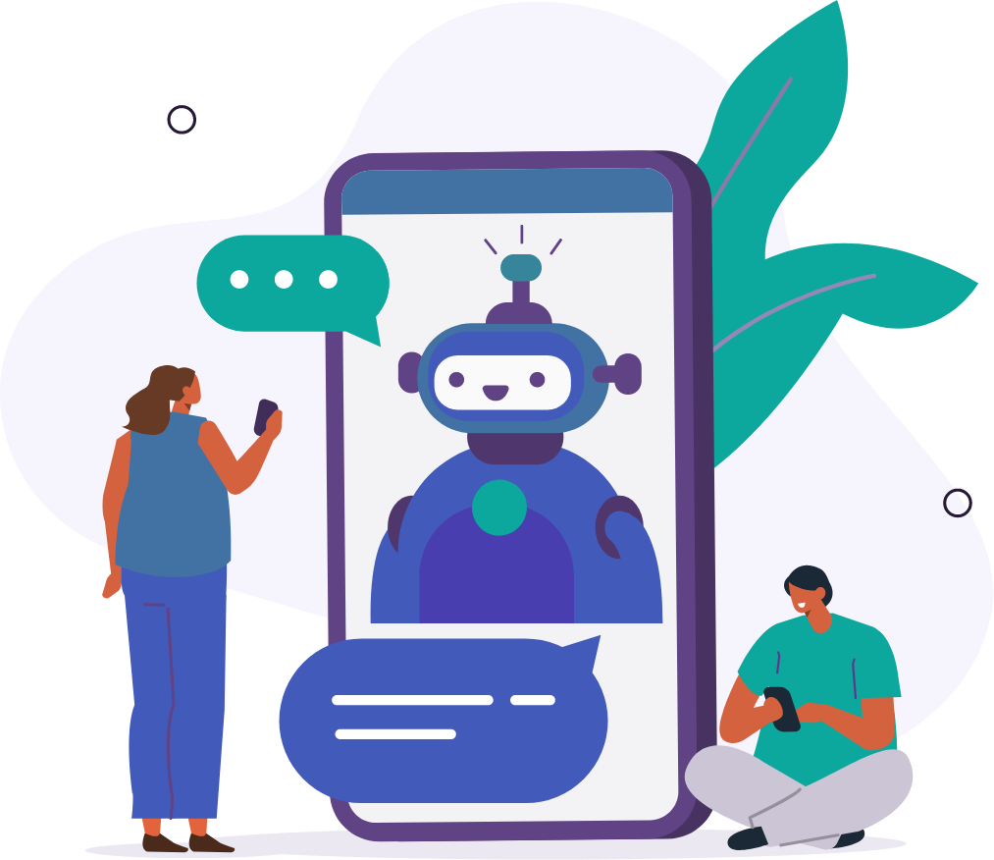
AI AUTOMATED CUSTOMER SERVICE CHAT BOT
Team 3 - Natalie Nye, Himanshi Tanwar, Colin Quinn, Roshan Dubey,
Shravanth Kulkarni

Slide 2

Contents
1
Business Problem & Solution
2
Architecture
3
Agile Process
4
Lessons Learned

Slide 3

Business problem & solution
Problem
Expensive Labor
Need for Automation
Solution
Customer Service Bot
Giving the Customer a great experience
Automated, seamless customer assistance
Simple - User Friendly
Notes:
We were given the task to create an architecture for a customer service chatbot. Currently there are many hours of time when Humans are trying to contact people with no answer. This adds a huge expense to MRS and with todays technology there can be an alternative.
We created a chatbot that allows us to give the customer a great experience that is a simplistic user friendly model. It will meet various needs of the customer such as answering questions and allowing for payments to be mad.
It will eliminate the need for a significant amount of labor. labor at the company.
We used agile tools to facilitate this process by asking the customer in depth questions to make
With that I will pass it onto Colin to describe the network.
"Improving customer experience"
"Regardless of day/time they can receive the answer they need"

Slide 4
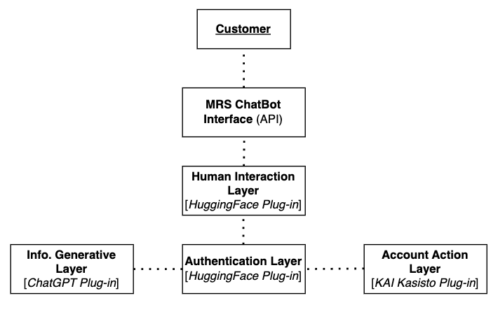

Network Diagram:
High-level

Slide 5
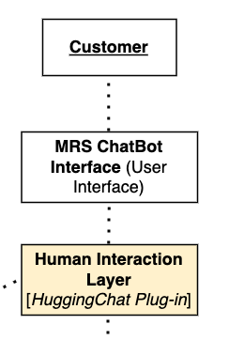
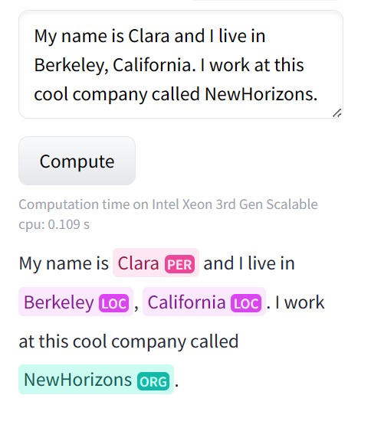
Human Interaction Layer
HuggingChat Plug-in
Social Interaction
Emotions Intelligence
Improvement Feedback
Contextual Awareness

Slide 6
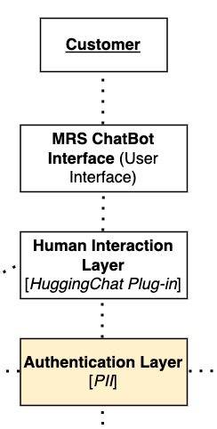
Authentication Layer
2 Options:
PII Authentication
Client Data
Google Authenticator
Notes:
Personal Identifiable Information
this will integrate within out chatbot bc it already will have access to client information so it will be easy for the person to verify things like
birthday
SS#
Account #
Google authenticator app-
free
widely used
simple process
used for commercial use
-although many people are more willing to give info to a bot bc not biased for the people that are nervous or that if that fact ever changes and pple are nervous to give out infor then can use authenticator cause not revealing info to a bot
-backup in case one fails
forgot password

Slide 7
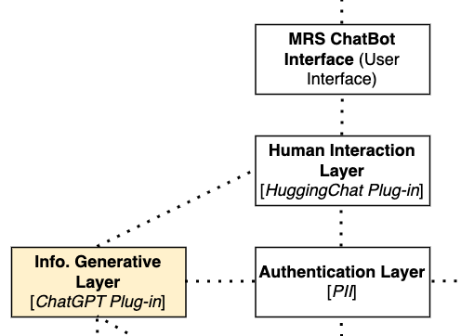
Info. Generative Layer
ChatGPT Plug-in
GPT-3 Architecture
24/7 Availability
Flexibility
Scalability
Continuous Learning
Broad Range of Data
Notes:
ChatGPT runs off of GPT-3 - a versatile model with approx. 175B parameters which offers the ability to perform tasks and provide contextually relevant responses
It has the ability to run 24/7 to mitigate the need for human interaction and facilitate the ability to answer consumers' queries and receive the answers they desire at any time/day
Next, ChatGPT is extremely flexible and offers the option to answer a broad range of questions from simple FAQ's - which often warrant the need for expensive human labor - to more elaborate questions regarding rules, regulations, policies, and procedures across financial institutions
It is hosted on a cloud-based infrastructure with the ability to handle large volumes of traffic (which is a factor for MRS), and offers the potential to mesh with other AI models as we've proposed to further enhance the consumer's experience
It can learn and update its responses based on data collected to continuously curate its responses more closely to the unique answers different consumers are looking for
Lastly, it offers an immense corpus of data ranging from simple text, books, articles, and websites, in addition to the critical client data

Slide 8
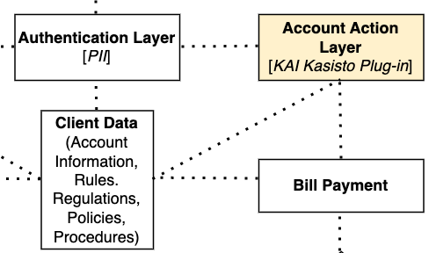
Account Action Layer
KAI Kasisto Plug-in
Account Related Actions
Outstanding Payment
Payment Condition verification
Payments and opt-out options

Slide 9
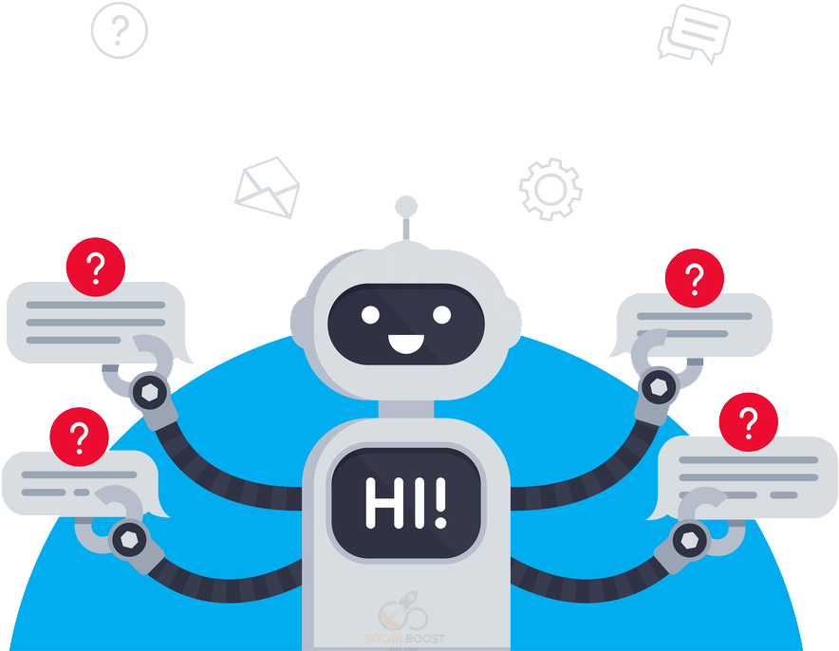
Architecture Functions Summary
Connected API's
Disaster Preparation
Human Contact
Encryption
Notes:
We believe we created Chatbot interface that uses a system of interconnected APIs that will satisfy all of the customers needs. It will eliminate the need for a significant amount of labor that is very expensive for the company. It will also allow for evenly distributed
immediate and imrpove customer service
low hanging fruit
-One thing that we considered with the interconnected system is that there is a possibility of failure with so many different integrated part and there may need to be backups incorporated in the model
-in our sample we have one example of failsafes in the two options for authentification
Although people may prefer to do things online a human touch can help to bring life to a cold conversation. With an issue like debt collection it has been found that people are more willing to pay when pple are nice to them so adding that human touch can help to collect data
Also allowing people to opt out and get in touch with a human can also help increase the collection rate. Also when the system notifies a human that the person has opted out of the chatbot they can be placed on the call list
It is key to have the entire system encrypted as there is a lot of sensitive information in the system. Each element of the architecture will include an encryption element.
and from there we would like to move onto talking a little about our process

Slide 10
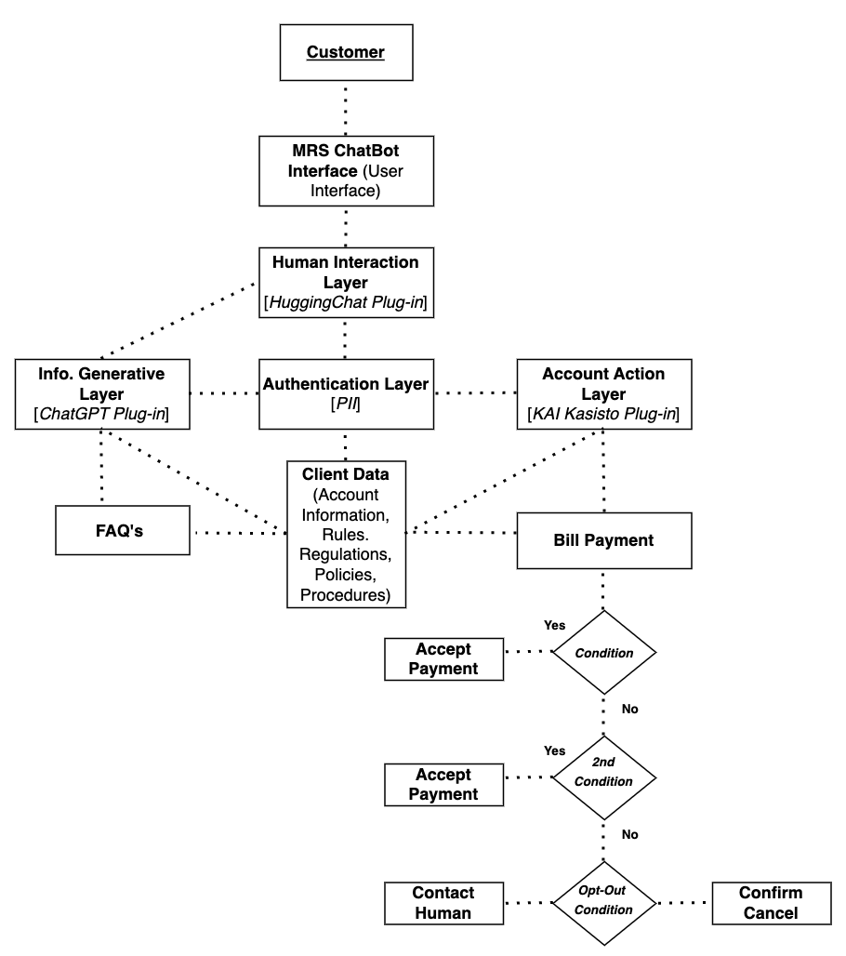
Network Diagram:
low-level

Slide 11
PROTOTYPE

Slide 12
Learning From Process
First Sprint
Sprints 2-4
Sprints 5-7
Improving process
Better Flow
Learning to be flexible
Smaller stories
Comfortable with process
Lots of visual aids
Reflection of process
Collaboration of ideas
Pre-planning
Researched chatbot
Learning process
Simple visual aids

Slide 13
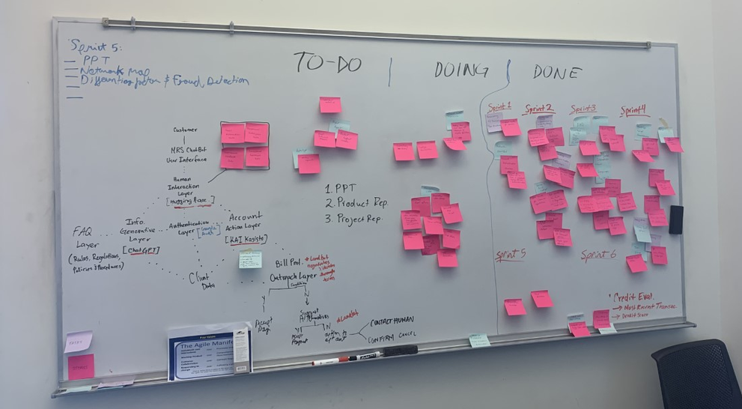
Summary and Lessons LEarned
Transparency
Flexibility
Communication
Move Items Through the process
Utilize unique areas of expertise
Identified strengths & weaknesses
Understood & managed stress points effectively
Making small changes
Identified priorities and re-oriented
Reflection on improvement
Transparency communication = progress
Create the optimal solution
Feedback over coaching
Gave guidance
Completing tasks
Easier Adjustments
Notes:
Communication
-talking allowed us to discover holes and gaps
-also allowed us to work more efficiently bc we knew what each other were best at
- discuss
deliver product in segments; prioritizing elements that are the most important. It allowed us to get it as close to what MRS was looking for in customer assistance

Slide 14
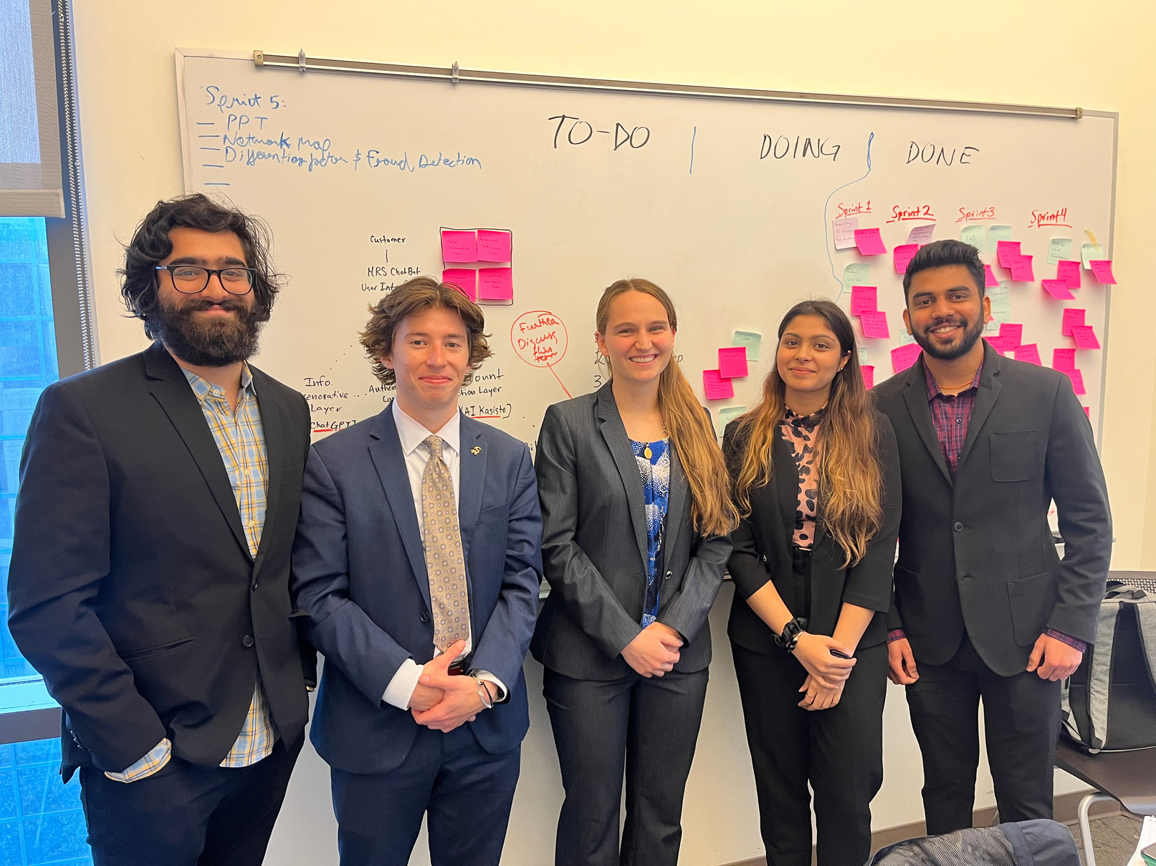
THANK YOU FOR LISTENING!
ANY QUESTIONS?
"Hey ChatGPT What is the best quote for the end of a presentation"

